Slide 1
Chapter one
Physiologic changes during pregnancy

Slide 2
Outline
Introduction
Physiologic changes in different body systems
Implication of physiologic changes during anesthesia
summary

Slide 3
Objectives
At the end of this chapter you should be able to:
Explain the physiologic changes during pregnancy in different body parts
Describe the implication of physiologic changes during anesthesia

Slide 5
Quiz
Briefly describe the anesthetic implication of physiologic changes on the respiratory system
What are the factors that reduce fetal exposure to anesthetic agents?
Briefly describe why physiologic changes occur during pregnancy.

Slide 6
Quiz
Briefly describe the anesthetic implication of physiologic changes on the respiratory system
What are the factors that reduce fetal exposure to anesthetic agents?
Briefly describe why physiologic changes occur during pregnancy.

Slide 7
Why physiologic changes occur during pregnancy?

Slide 8
Introduction
Maternal physiological changes during pregnancy occurs due to :
Hormonal alterations
Mechanical effects of the gravid uterus
Increased metabolic and oxygen requirements
Hemodynamic alterations associated with the placental circulation

Slide 9
Introduction
Physiological changes are essential to:
support and protect the developing fetus and
to prepare the mother for parturition

Slide 10
Introduction...cont’d
Pregnancy represents a serious challenge to all body systems
This causes no major problems for healthy women
Causes significant adaptation problem in women with clinical or subclinical pathologies
The physiologic changes can directly affect the anesthesia technique.....

Slide 11
Cardiovascular changes

Slide 12
Heart rate and stroke volume
heart rate ↑20-30%
Starts ≈ 4th to 5th wk GA
A response for ↓ SVR
↑ by 20% in the 3rd trimester
SV ↑ 20-50%

Slide 13
Cardiac output
CO ↑30-50% ,starting ≈5 wks after conception
↑SV and HR
20-30% ↑CO at 2nd trimester
3rd trimester it ↓s in supine position
Aortocaval compression
↑s during Labor and delivery

Slide 14
Cardiac output
In valvular and coronary heart disease
Might not be well tolerated
Risk of decompensation:
24 wks of gestation
Labor
Immediately after delivery(↑CO by 50% of predelivery values)
CO, HR and SV
24-72 hrs post partum→ prelabor value
6-8 wks after delivery→ non-pregnant value

Slide 15
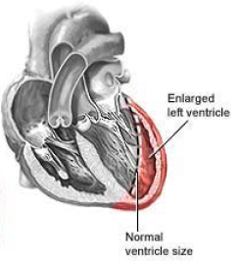
Cardiac changes
Both position and size change
The heart is enlarged
Flow murmurs...↑plasma volume and CO
Regurgitant murmurs...cardiac dilatation

Slide 16
ECG
Anatomically the heart is displaced upward and to the left by the gravid uterus
left axis deviation
ST segment depression and
T wave flattening

Slide 17
Hemodynamics
SVR ↓s by 20%
Vasodilatory effects of progesterone
Proliferation of low resistance vascular beds in the inter-villous spaces of the placenta
DBP ↓s by 20%
SBP ↓s by 8%
Supine hypotension syndrome

Slide 18
Blood pressure
Blood pressure ↓s → peripheral vasodilation
peripheral arterial vasodilatation in early pregnancy is mediated by progesterone
↓s by ≈ 10% by 7–8 wks of gestation
Peak fall occurs around 24 wks of gestation
Returns to pre-pregnancy value at term

Slide 19
Blood volume
↑Blood volume – (fetal and maternal
hormone production)
- plasma volume…↑40-50%
- RBC...↑15-20%(↑erythropoietin production)
- iron deficiency anemia
- WBC ↑s
15% drop in hemoglobin concentration
Physiologic/dilutional anemia

Slide 20
Blood volume
↑s progressively from 6 - 8 wks of gestation
Reaches maximum ≈ 32 – 34 wks of gestation
No sign of overload in a healthy pregnant women

Slide 21
Blood volume...cont’d
The increased blood volume:
Facilitates maternal and fetal exchanges of respiratory gases, nutrients and metabolites
Reduces the impact of maternal blood loss at delivery
It takes about 8 wks after delivery for the blood volume to return to normal

Slide 22
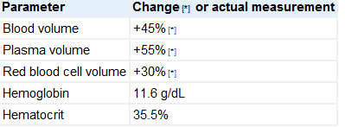
...cont’d

Slide 23
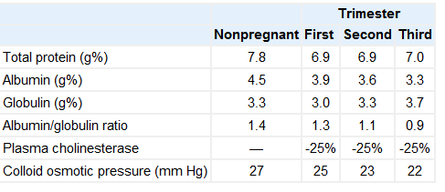
Plasma protein

Slide 24
Coagulation
Pregnancy is a relatively hypercoagulable state
An ↑ in clotting factors
Prevents excessive bleeding at delivery
↑s the risk of thromboembolism

Slide 25
Coagulation factors in pregnancy
Factor | Change
II (prothrombin) | Unchanged
V (proaccelerin) | Unchanged
I (Fibrinogen ) | Increased +++
VII (proconvertin) | Increased +++
VIII (antihemophilic) IX (Christmas ) X (Stuart-Power) XII (Hageman) | Increased
Platelets | No change or decreased
XI (thromboplastin antecedent) | reduced
XIII (fibrin stabilizing factor) | reduced

Slide 26
Summery of cardiovascular changes during pregnancy
Parameter | Change | Amount(%)
Heart rate | Increased | 20 - 30
Stroke volume | Increased | 20 - 50
Cardiac output | Increased | 30 - 50
Contractility | Variable | ± 10
Central venous pressure | Unchanged
Pulmonary capillary wedge pressure | Unchanged
Systemic vascular resistance | Decreased | 20
Systemic blood pressure | Slightly decreased | Mid trimester 10 – 15 mmHg then rises
Pulmonary vascular resistance | Decreased | 30
Pulmonary artery pressure | Slightly decreased

Slide 27
Respiratory
Anatomy
Circumference of thoracic cage increases by 5 to 7 centimeter
→↑in anteroposterior and transverse diameter(2cm)
Flaring of the ribs
68.5 to 103.5 degree
↓ In vertical chest measurement by 4 cm
Elevated position of the diaphragm

Slide 28
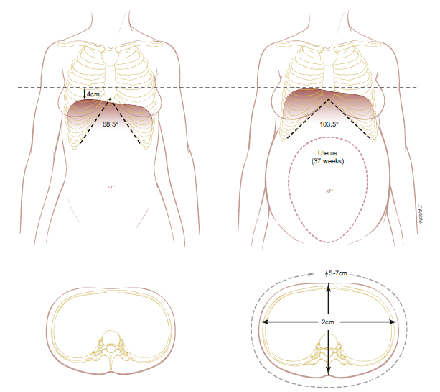
Chest wall changes
An increase in subcostal angle, anterior-posterior and transverse diameter and chest
wall circumference

Slide 29
Respiratory ... Cont’d
Mechanical
Diaphragmatic excursion ↑s
Chest wall excursion ↓
Pulmonary resistance ↓
Closing capacity – no change(upright position)
Lung compliance is unchanged but chest wall compliance decreases

Slide 30
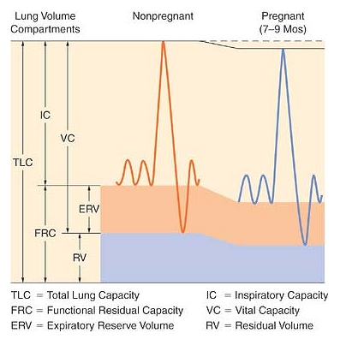
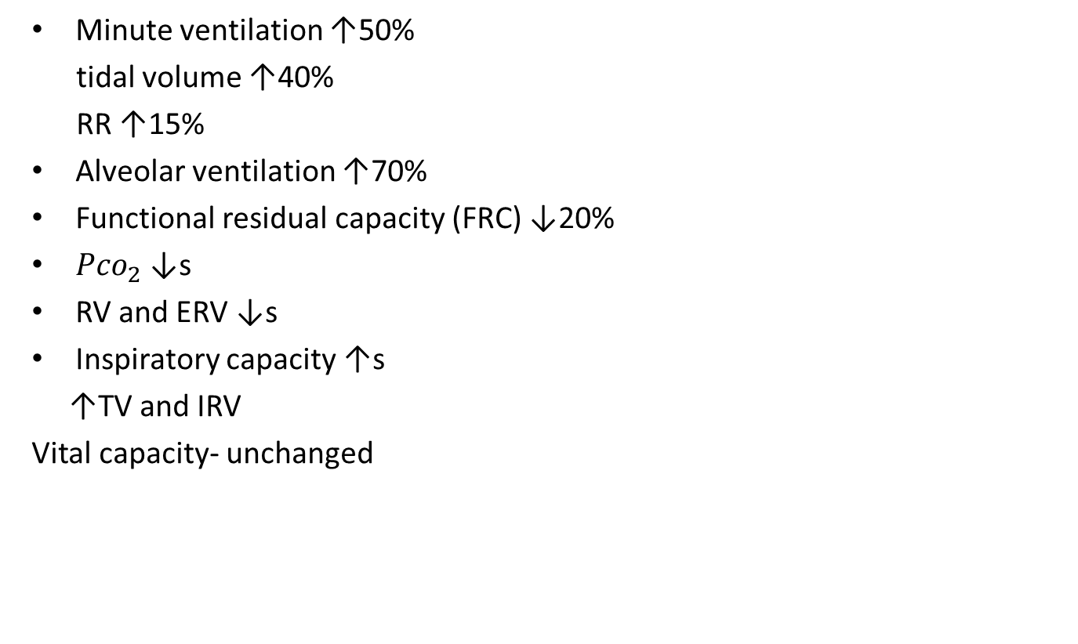
Respiratory changes
Minute ventilation ↑50%
tidal volume ↑40%
RR ↑15%
Alveolar ventilation ↑70%
Functional residual capacity (FRC) ↓20%
${Pco}_{2}$ ↓s
RV and ERV ↓s
Inspiratory capacity ↑s
↑TV and IRV
Vital capacity- unchanged

Slide 31
Respiratory … cont’d
Total lung capacity- slightly reduced
↑in chest circumference
Respiratory mucus membrane – vascular, edematous and friable
The ratio FRC/CC ↓s → faster small-airway closure when lung volume is reduced; thus, parturients can desaturate at a much faster rate

Slide 32
...cont’d
Hyperventilation
progesterone effect decreases the threshold and increases the sensitivity of the central ventilatory chemoreflex response to CO2
an increased metabolic rate and
increased CO2 production
The PaCO2 decreases from 35 to 40 mmHg to 30 to 32 mm Hg

Slide 33
...cont’d
Compensatory renal mechanisms
excrete bicarbonate→ bicarbonate level of 18 to 22 mEq/L in late pregnancy
The chronic alkalosis→ stimulates 2,3-DPG synthesis → a rightward shift of the oxyhemoglobin dissociation curve, which aids oxygen transfer across the placenta

Slide 34
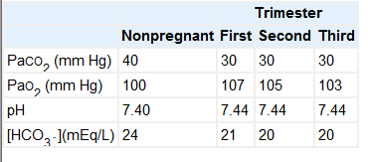
Blood gases during pregnancy

Slide 35
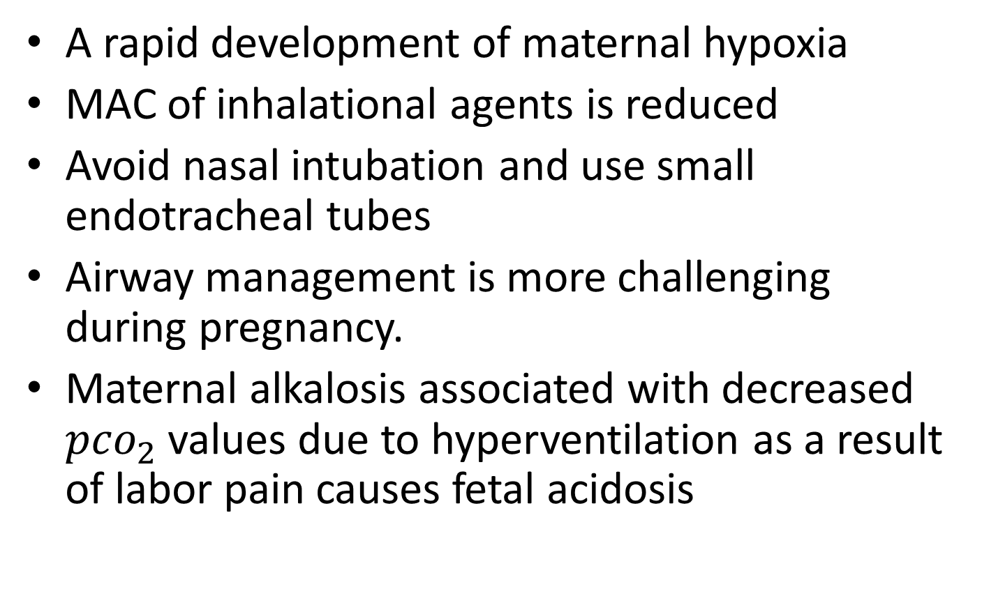
Implication
A rapid development of maternal hypoxia
MAC of inhalational agents is reduced
Avoid nasal intubation and use small endotracheal tubes
Airway management is more challenging during pregnancy.
Maternal alkalosis associated with decreased ${pco}_{2}$ values due to hyperventilation as a result of labor pain causes fetal acidosis

Slide 36
Gastrointestinal system changes
Morning sickness
Early pregnancy(hormonal changes)
↓Intestinal motility and food absorption
Reflux and heartburn
Lower esophageal sphincter relaxation
Increased intragastric pressure(enlarging uterus)

Slide 37
Gastrointestinal....cont’d
The gastric emptying time of solid as well as liquid material is not changed during pregnancy (controversial)
Gastric emptying time is significantly slower during labor and hence gastric volume is increased

Slide 38
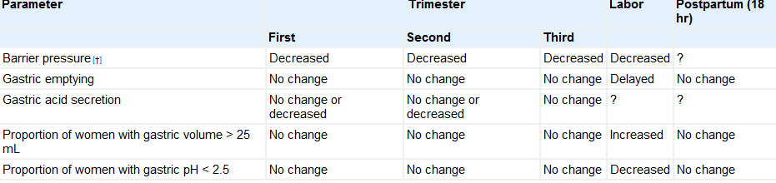
Change in gastro intestinal physiology during pregnancy

Slide 39
Implications
Considered to have a full stomach irrespective of the time of their last meal
General anesthesia should be avoided when possible
Use cuffed endotracheal tubes
The routine use of non particulate anti acid is important

Slide 40
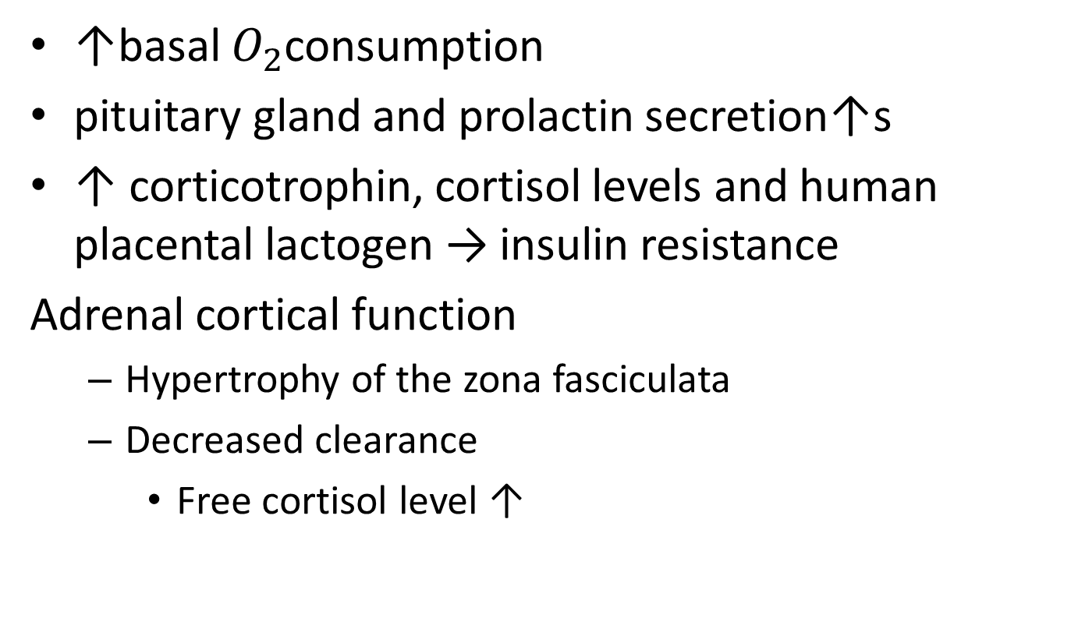
Metabolism and endocrine
↑basal $O_{2}$consumption
pituitary gland and prolactin secretion↑s
↑ corticotrophin, cortisol levels and human placental lactogen → insulin resistance
Adrenal cortical function
Hypertrophy of the zona fasciculata
Decreased clearance
Free cortisol level ↑

Slide 41
Endocrine
Thyroid
gland enlarges-hyperplasia and increased vascularity
↑ T3 and T4 production
↑in thyroid-binding globulin
Pregnancy is a state of iodine deficiency
Inadequate intake
Increased renal clearance
TSH decreases while T3 and T4 remains constant
HCG is structurally similar with TSH

Slide 42
...cont’d
Pancreas
↑ed insulin secretion
β-islat cells hyperplasia
Insulin resistance
corticotrophin, cortisol levels and human placental lactogen → insulin resistance
development of gestational diabetes
exacerbation of preexisting DM
Decreased glucose tolerance

Slide 43
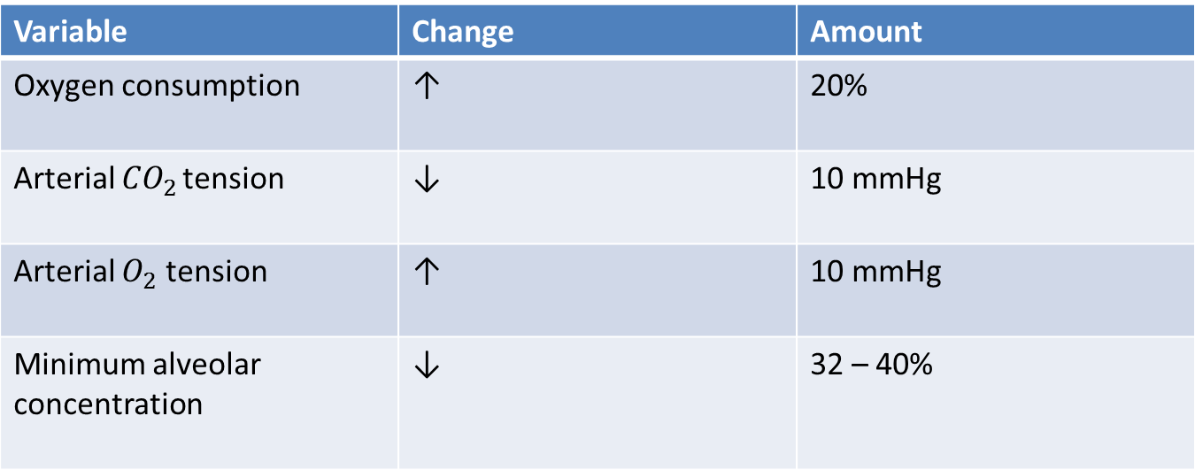
Metabolic changes
Variable | Change | Amount
Oxygen consumption | ↑ | 20%
Arterial ${CO}_{2 }$tension | ↓ | 10 mmHg
Arterial $O_{2}$ tension | ↑ | 10 mmHg
Minimum alveolar concentration | ↓ | 32 – 40%

Slide 44
Nervous system
Increased sensitivity to both general and regional anesthetics
- reduced plasma and CSF protein
- hormonal changes
MAC decreased
- halothane 25%
- isoflurane 40%

Slide 45
Nervous...cont’d
Alterations in mood and cognitive functions
Hemodynamic stability depends on SNS
Epidural anesthesia – wider dermatomal spread
elevation in the threshold to pain and discomfort near the end of pregnancy and during labor
endorphins, enkephaline and others

Slide 46
kidney
The kidneys increase in length ≈ 1 cm as a result of the increase in blood volume
↑GFR 50%
Rise in urea, creatinine and uric acid clearance
Glycosuria
Reduced distal tubular reabsorption
↑GFR

Slide 47
Kidney... Cont’d
Protein uria
↑ed tubular reabsorption of sodium
ureters and renal pelvis dilate
Urinary stasis...
The GFR and BUN concentration slowly return to non pregnant values by the sixth post partum week

Slide 48
Parameter | pregnant
Creatinine clearance | 150 to 200 mL/min
BUN | 8 to 9 mg/dl
Serum creatinine | 0.5 to 0.6 mg/dl

Slide 49
Implication
Non pregnant values of BUN and creatinine in parturient will suggest abnormal kidney function
Urinary stasis predisposes them to infection

Slide 50
Liver
The liver size, morphology, and blood flow do not change during pregnancy
Upward, posterior and to the right displaced

Slide 51
liver
Serum bilirubin raise to
Alanine aminotransferase (ALT,SGPT) the upper
Aspartate aminotransferase(AST,SGOT) limit
Lactic dehydrogenase
An ↑in total plasma alkaline phosphatase concentration ( placental production)

Slide 52
...Cont’d
Impaired gall bladder function and empting
Reduction in serum cholinesterase activity
normal dosing of succinylcholine for intubation (1 to 1.5 mg/kg ) is not associated with prolonged neuromuscular blockade

Slide 53
Physiological change in the other parts of the body
Weight gain 17% of non pregnant weight(10 to 12kg)
1st trimester 1-2 kg
2nd and 3rd trimester 5-6 kg
Generalized ligamentous relaxation and softening of collagenous tissues
Relaxin
Hyperpigmentation of certain parts of the body
Enlargement of the breast
Reduction in intraocular pressure

Slide 54
Physiological change in the other parts of the body
Weight gain 17% of non pregnant weight(10 to 12kg)
1st trimester 1-2 kg
2nd and 3rd trimester 5-6 kg
Generalized ligamentous relaxation and softening of collagenous tissues
Relaxin
Hyperpigmentation of certain parts of the body
Enlargement of the breast
Reduction in intraocular pressure

Slide 55
What is the anesthetic implication of the physiologic changes?

Slide 56
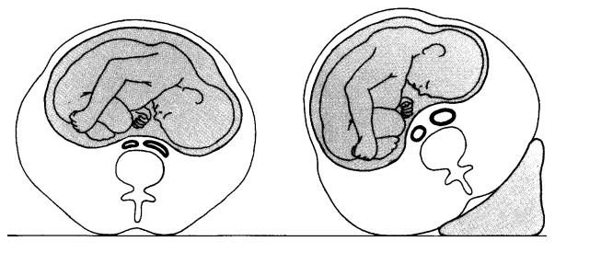
Anesthetic implications of physiologic changes
Positioning of pregnant woman
Minimize aortocaval compression in all pregnant women by placing a cushion or wedge under the parturient’s right hip.

Slide 57
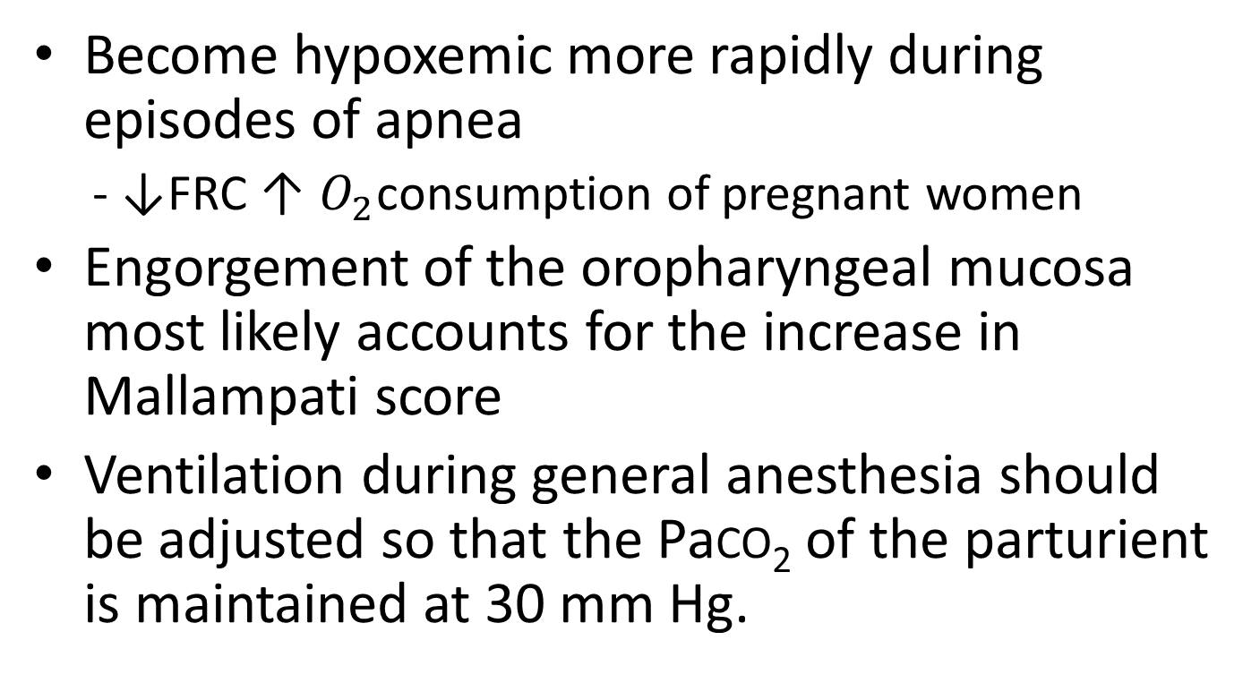
...cont’d
Become hypoxemic more rapidly during episodes of apnea
- ↓FRC ↑ $O_{2}$consumption of pregnant women
Engorgement of the oropharyngeal mucosa most likely accounts for the increase in Mallampati score
Ventilation during general anesthesia should be adjusted so that the Paco₂ of the parturient is maintained at 30 mm Hg.

Slide 58
...cont’d
Allowing the Paco₂ to increase to the normal level for nonpregnant women (40 mm Hg) results in acute respiratory acidosis
The ↑ed MV combined with ↓ed FRC enhances inhalation induction or changes in depth of anesthesia when breathing spontaneously

Slide 59
...cont’d
Aspiration prophylaxis is necessary
clear antacids such as sodium citrate (0.3mol) or bicarbonate should be used
H2 receptor antagonists
a cuffed endotracheal tube is mandatory
a reduced drug requirement, manifest in both regional and general anesthesia

Slide 60
Anesthetic implication…cont’d
Blood replacement
Parturients can tolerate greater blood loss than non pregnant women undergoing surgery
Blood loss up to 500 ml do not need to be replaced for hemodynamic stability during delivery

Slide 61
Anesthetic consideration... Cont’d
General anesthesia
Endotracheal intubation
Smaller endotracheal tubes required
Increased risk of trauma with nasotracheal intubation
Increased risk of failed intubation
Increased risk of pulmonary aspiration of gastric content

Slide 62
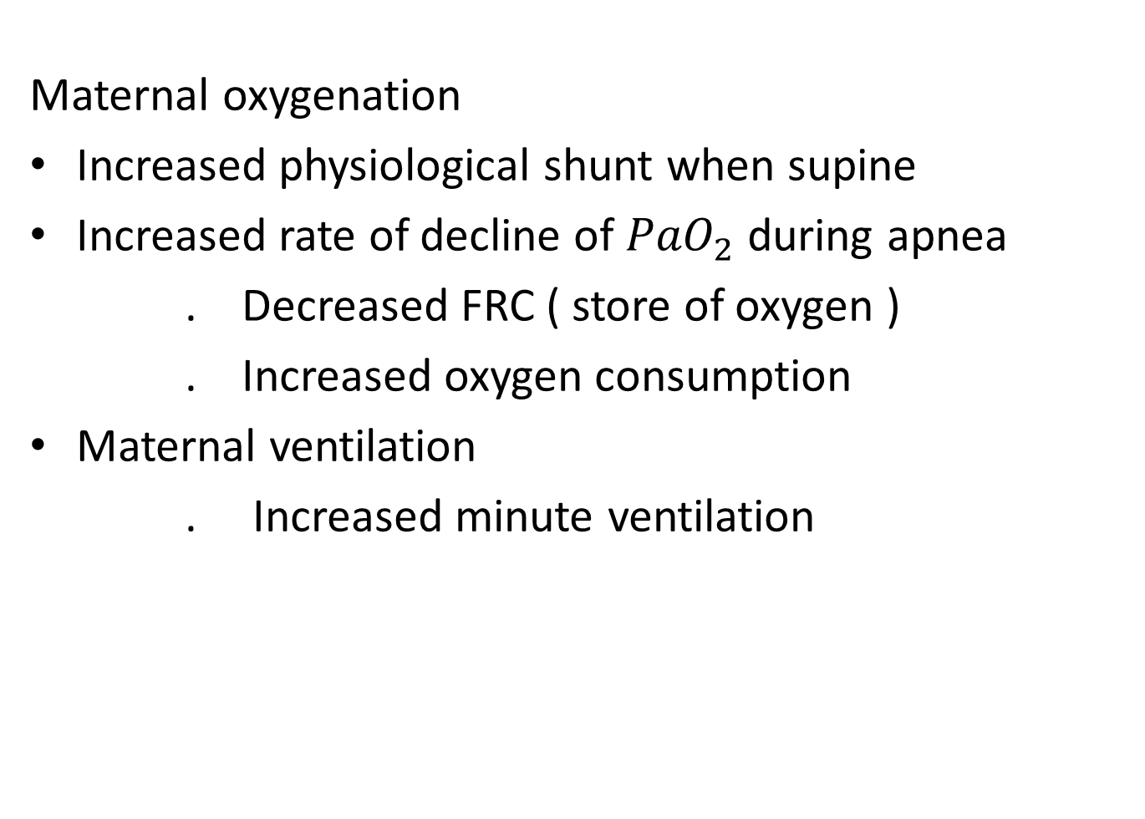
Anesthetic implication…cont’d
Maternal oxygenation
Increased physiological shunt when supine
Increased rate of decline of ${PaO}_{2}$ during apnea
. Decreased FRC ( store of oxygen )
. Increased oxygen consumption
Maternal ventilation
. Increased minute ventilation

Slide 63
...cont’d
Pregnant and postpartum women exhibit enhanced sensitivity to the aminosteroid muscle relaxants vecuronium and rocuronium
Atracurium – no alterations
The chronotropic response to isoproterenol and epinephrine is reduced (down-regulation of beta-adrenergic receptors)
less sensitive markers of IV injection during RA

Slide 64
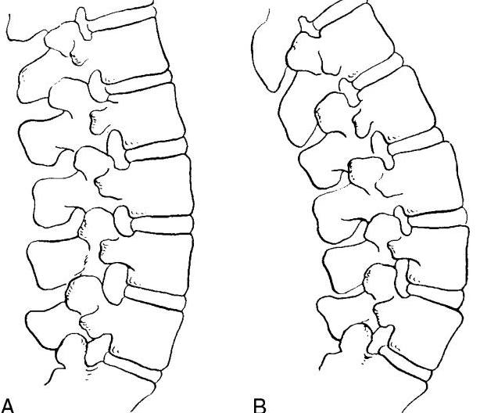
Anesthetic implication … cont’d
Regional anesthesia
Technical difficulty during regional anesthesia may occur due to enhanced lumbar lordosis and it reduces the vertebral interspinous gap.
Non pregnant
pregnant

Slide 65
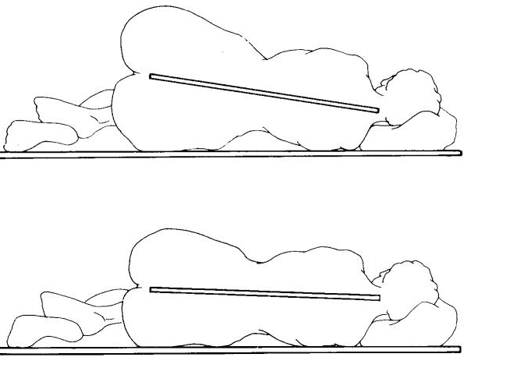
Anesthetic implication…cont’d
Widening of the pelvic results in head- down tilt when the parturient is in lateral position.
If hyper baric solution is injected in this position the head-down tilt will enhance the spread of anesthetic solution.
Pregnant
Non pregnant

Slide 66
...cont’d
Distension of the extradural veins ↑s the risk of vascular damage during institution of a regional block
The increased venous volume within the rigid spinal canal reduces the volume or capacity of the extradural and intrathecal spaces for local anesthetic solutions→ increase the spread of injected drugs

Slide 67
...cont’d
phenylephrine and ephedrine have similar efficacy in the treatment of hypotension
rapid onset and a longer duration of spinal anesthesia than nonpregnant women
Pregnancy enhances the neural sensitivity of peripheral nerves to local anesthetics

Slide 68
Summary

